Slide 1



Introduction to Python

Slide 2
1. Introduction to Python
What is Python? Why Python?
Applications of Python
Python versions (Python 2 vs Python 3)
Installing Python and setting up the environment (VSCode, Jupyter Notebook, Google Colab)
Writing your first Python program: Hello, World!

Slide 3

What is Python? Why Python? -2
The name Python is said to come from the British comedy series Monty Python's Flying Circus.
Python was conceived in the late 1980s by Guido van Rossum at Centrum Wiskunde & Informatica (CWI) in the Netherlands

Slide 4
What is Python? Why Python?
What is python,
general purpose interpreted programming language is a language that supports multiple approaches to software design, principally structured and object-oriented programming.
provides automatic memory management and garbage collection
extensible
dynamically typed

Slide 5
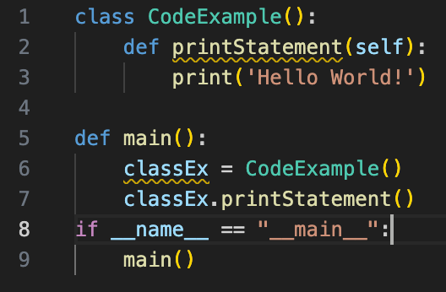
How is it look like?
Indentation is the key.

Slide 6
What is Python? Why Python? - 3
Python is widely used because of:
Easy to Read and Write – Simple syntax similar to English.
Interpreted Language – No need to compile code.
Cross-Platform – Works on Windows, macOS, Linux.
Extensive Libraries – NumPy, Pandas, Matplotlib, TensorFlow, etc.
Versatile – Web development, data science, AI, automation, and more.
Strong Community – Large support network and open-source contributions.

Slide 7
Python Comparison with Other Languages
Feature | Python | Java | C++ | JavaScript
Syntax Simplicity | Easy | Complex | Complex | Moderate
Speed | Slower | Faster | Faster | Faster
Readability | Very High | Moderate | Low | High
Use Cases | Versatile | Enterprise | System Programming | Web & Frontend

Slide 8
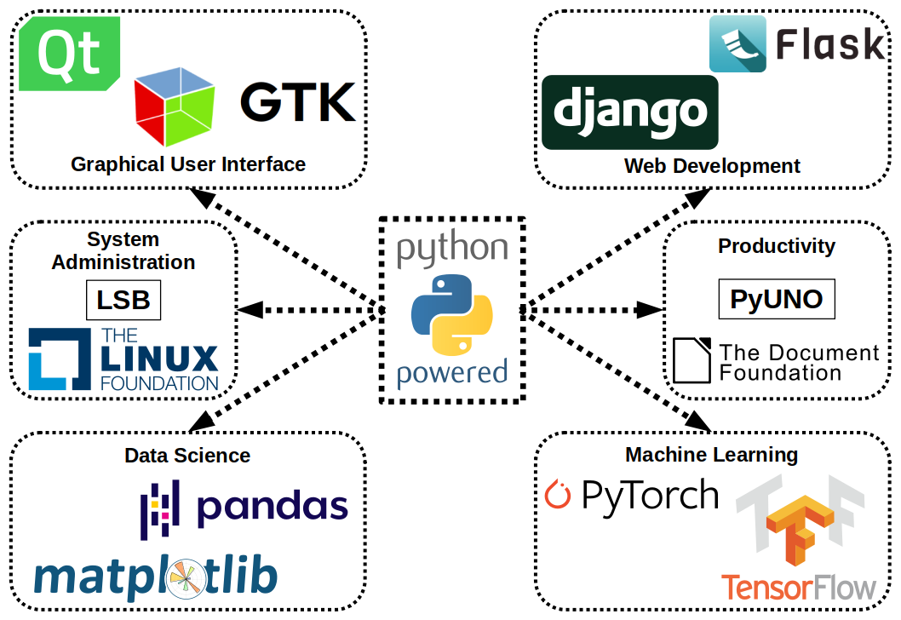
Applications of Python
Data Science & Machine Learning – Pandas, Scikit-learn, TensorFlow
Web Development – Django, Flask
Data Visualization – Matplotlib, Seaborn, Plotly
AI & Automation – OpenCV, Selenium
Bioinformatics – Biopython, Nextflow integration
Scripting & Automation – Automate tasks, file handling
Game Development – Pygame

Slide 9
Applications of Python in Bioinformatics
Library | Purpose
Biopython | Sequence analysis, file parsing (FASTA, GenBank)
pandas | Data manipulation for genomic datasets
NumPy/SciPy | Statistical analysis in biological research
matplotlib & seaborn | Visualization of biological data
scikit-learn | Machine learning for genomics
pyGenomeViz | Genome visualization
PyMOL API | Protein structure visualization

Slide 10
Python versions (Python 2 vs Python 3)
Genomic Epidemiology Applications:
Tracking pathogen evolution (Nextstrain, Microreact)
Outbreak detection and response
Real-time data processing in pandemics
AMR surveillance using Python-based pipelines
Example Tools: Nextflow, Snakemake for workflow automation

Slide 11
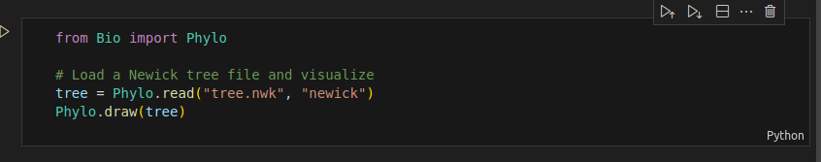
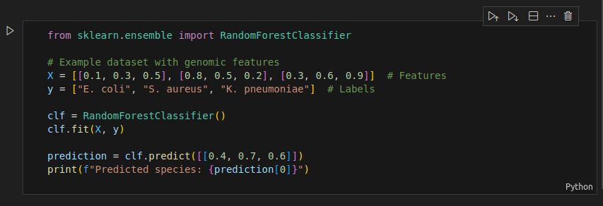
Examples of Code Blocks

Slide 12
Language and Compiler? What I need?
A language is a structured system of communication, used in computing to give instructions to a computer. Programming languages (e.g., Python, C, Java) allow developers to write code that computers can understand and execute.
A compiler is a special program that translates code written in a high-level programming language into machine code (binary) that a computer's processor can execute. Unlike interpreters, which execute code line by line (e.g., Python), compilers translate the entire program before execution (e.g., C, Java).

Slide 13
Language, Compiler and Interpreter?
An interpreter is a program that executes code line by line, rather than compiling the entire program beforehand. It translates high-level programming language code into machine code dynamically at runtime.

Slide 14
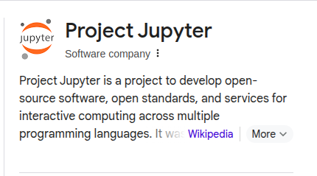
What is Jupyter Notebook?
Jupyter Notebook is an interactive computing environment that allows you to create and share documents containing live code, equations, visualizations, and text. It is widely used in data science, machine learning, and scientific computing.

Slide 15
How to use python in your computer?
Download Python from the official site: https://www.python.org/downloads/windows/
Run the installer and check "Add Python to PATH" before installing.
Open Command Prompt (cmd) or PowerShell, then type:
python
To run a script on windows cmd:
python script.py

Slide 16
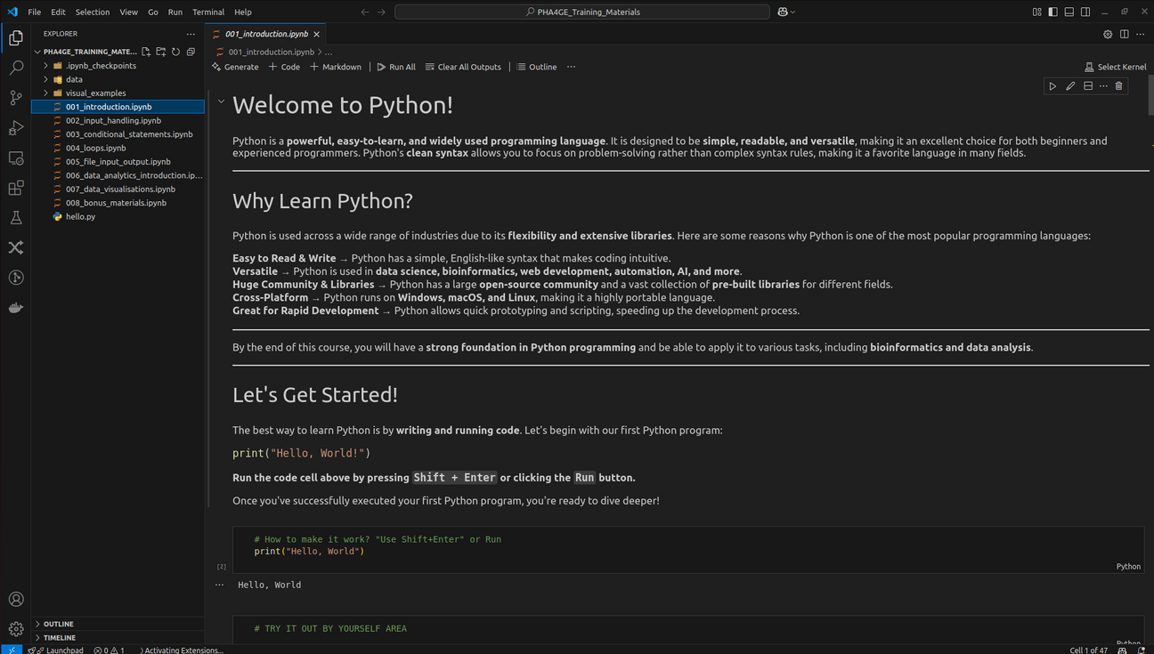
How to use python in your computer? (Windows)
VSCODE
https://code.visualstudio.com/docs/setup/windows

Slide 17
How to use python in your computer? (Windows)
macOS comes with Python 2.x pre-installed, but you should use Python 3. To install:
brew install python3
python3 or python3 script.py

Slide 18
How to use python in your computer? (MacOS)
VSCODE
https://code.visualstudio.com/docs/setup/mac

Slide 19
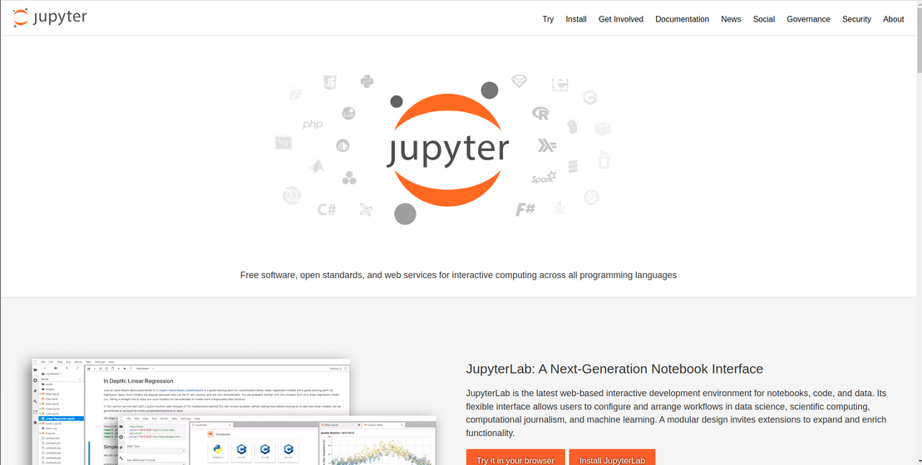
Installing Python and setting up the environment (Jupyter Notebook)
We will use Jupyter Notebook from now on for exercises. Let’s install it to our the computers.
Go to: https://jupyter.org/

Slide 20
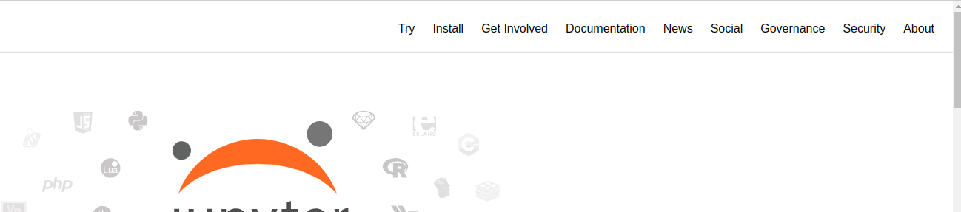
Installing Python and setting up the environment (VSCode, Jupyter Notebook, Google Colab)
Click Install

Slide 21
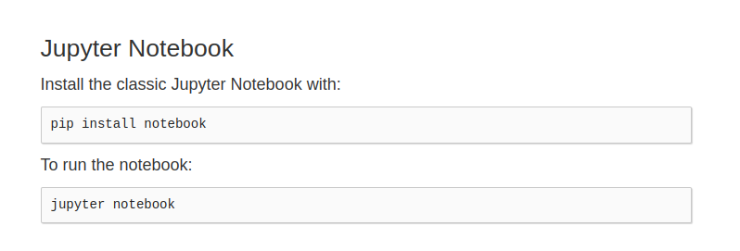
Installing Python and setting up the environment (VSCode, Jupyter Notebook, Google Colab)
Select Appropiate option for yourself
We need Jupyter Notebook

Slide 22
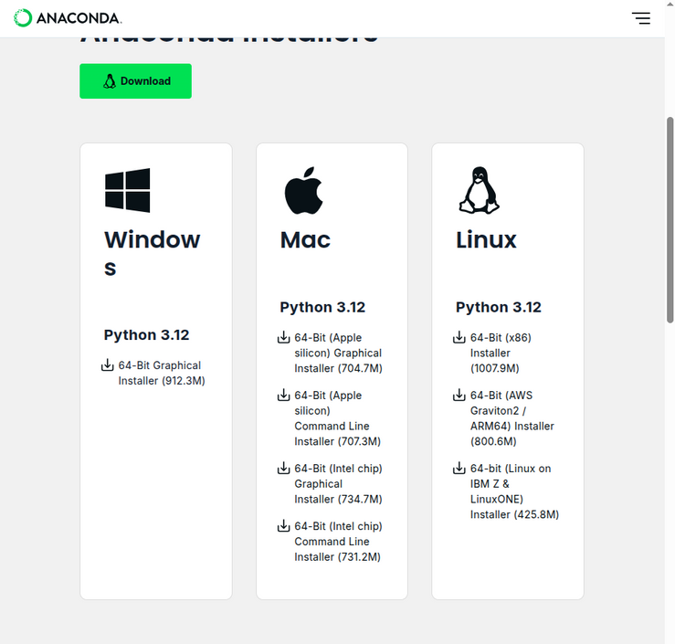
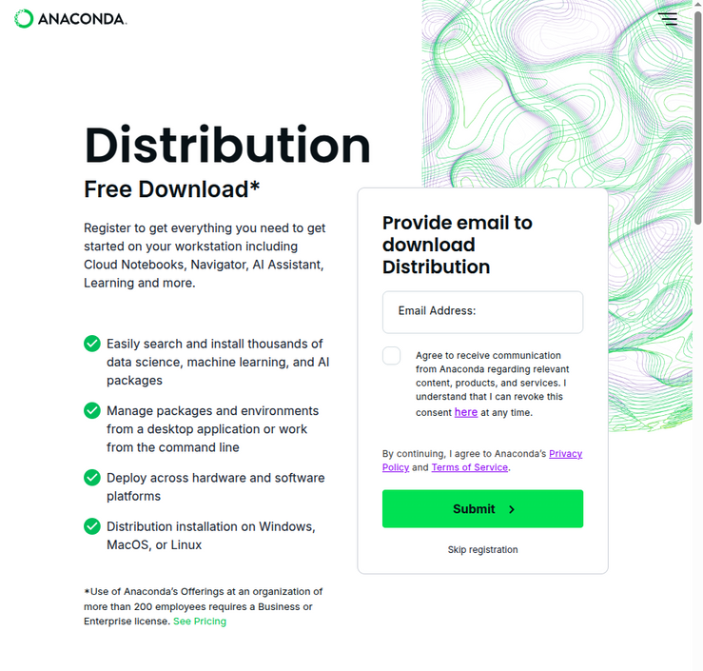
Installing Python and setting up the environment (Jupyter Notebook)
In a windows computer you may need to download anaconda which includes all of the packages and jupyter notebook in it.

Slide 23
Let’s download out training materials from GitHub!
TBC

Slide 24
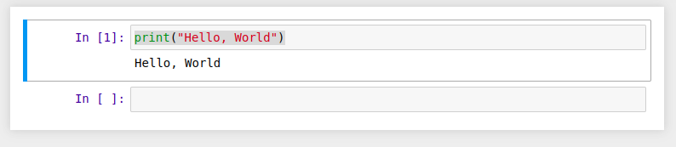

Writing your first Python program: Hello, World!
After Installing Jupyter Notebook, please open 001_Introduction.ipynb

Slide 25
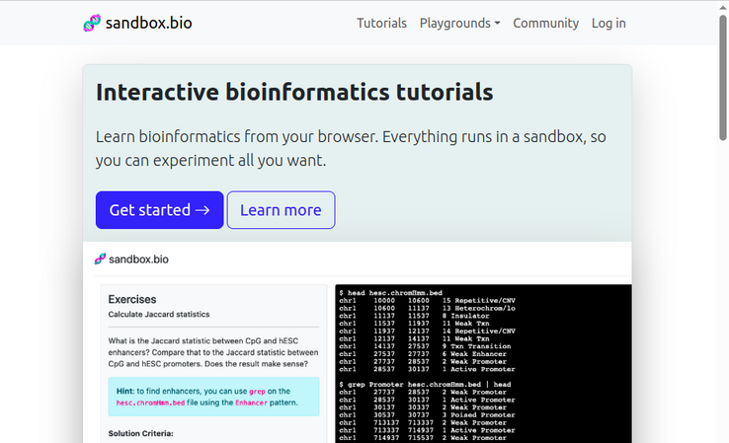
Other Tutorials for you!

Slide 26
References
Python Official Docs: https://docs.python.org/3/
Best for understanding core Python concepts and functions.
Python Tutorial: https://docs.python.org/3/tutorial/index.html
Step-by-step guide for Python basics.
Real Python: https://realpython.com/
In-depth articles and tutorials.
Python Full Course (freeCodeCamp):
https://www.youtube.com/watch?v=rfscVS0vtbw
ADVANCED PART!
Data Science & Pandas: https://pandas.pydata.org/docs/
Machine Learning with Python: https://scikit-learn.org/
Nextflow for Bioinformatics https://www.nextflow.io/docs/latest/

